Slide 1
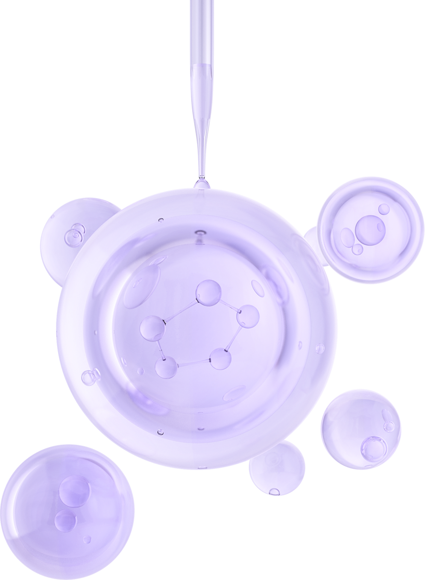
Sept 14, 2025
NOVAMOL
GENERATIVE MODEL FOR NOVEL CHEMICAL MOLECULES
Group No: 17
Group Members:
Ahmed Abdul Wasae - A0328301R
Hari krishna Dhamodaran - A0333806E
Raja Vijayakumar - A0327096X
John Joseph Peter - A0328845R

Slide 2
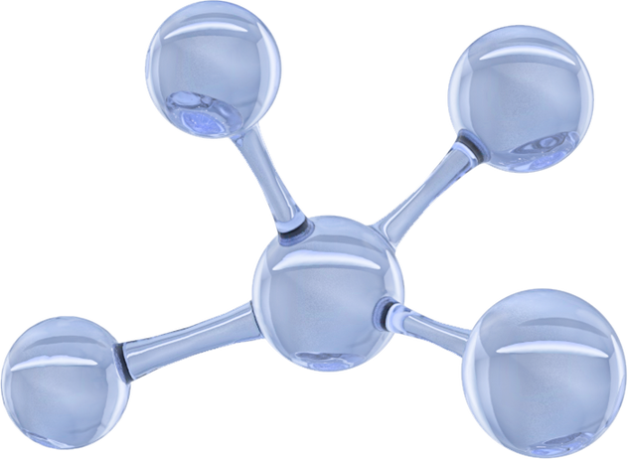
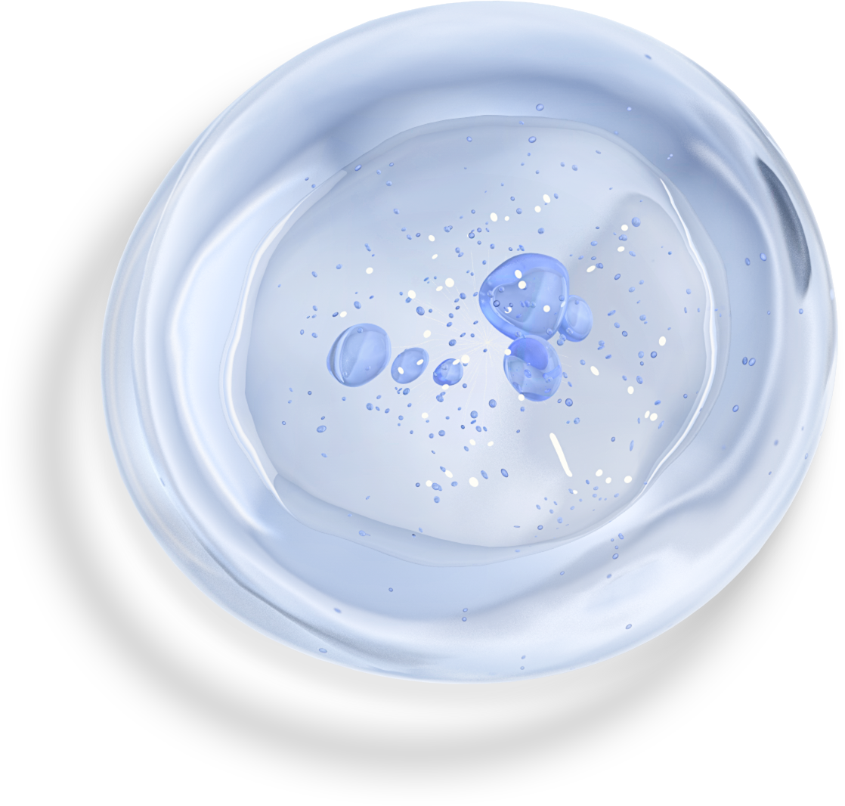
Introduction
Discovering new molecules and understanding their properties is a critical step in developing advanced drugs, sustainable materials, and innovative chemicals. Traditional discovery methods are often slow, costly, and resource-intensive. This project leverages artificial intelligence to identify patterns in existing molecular structures and properties, enabling the generation of novel candidate molecules and the prediction of their potential functionalities. By combining data-driven techniques with chemical knowledge, the project aims to accelerate molecular discovery while reducing experimental costs.

Slide 3
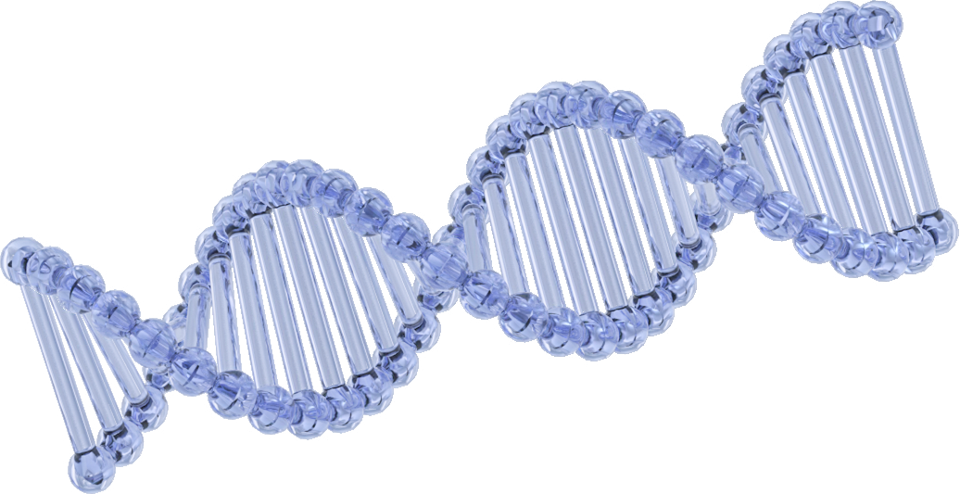
Project Background and Market Context
Problem Today: Discovering new molecules is slow, costly, and trial-and-error based. Traditional lab experiments and simulations take months or years.
Why AI Helps: AI can predict molecular properties without running every experiment. This saves time, money, and resources in discovery.
Market Needs
Pharma: Faster drug discovery and lead optimization.
Materials Science: New polymers, batteries, solar materials.
Food & Fragrance: Novel safe flavour and aroma compounds.
Agrochemicals: Eco-friendly pesticides and additives.
Opportunity: AI-driven molecule generation can shorten R&D cycles. Growing demand for faster, cheaper, and sustainable innovation across industries.

Slide 4
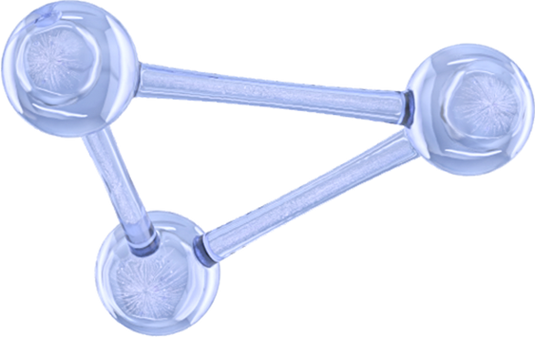
Literature Review
1. Molecular Graph Neural Networks
Paper: “Neural Message Passing for Quantum Chemistry” – Gilmer et al., ICML 2017
Introduced message-passing GNNs for predicting molecular properties.
Paper: “Graph Attention Networks” – Veličković et al., ICLR 2018
Attention-based GNN for molecular and general graph data.
2. Molecular Generation with RNN / SELFIES
Paper: “SELFIES: A Robust Representation of Semantically Constrained Graphs” – Krenn et al., 2020
SELFIES ensure chemically valid sequences for generative models.
Paper: “Molecular Generation with Recurrent Neural Networks” – Segler et al., 2018
Demonstrates SMILES-based RNNs for de novo molecule generation.
3. Graph-based Property Prediction
Paper: “Benchmarking Graph Neural Networks for Molecule Property Prediction” – Wu et al., 2018
Extensive comparison of GNN architectures for quantum chemistry datasets.
4. Integration of Generation + Property Prediction
Paper: “Junction Tree Variational Autoencoder for Molecular Graph Generation” – Jin et al., ICML 2018
Generates molecules as graphs while ensuring chemical validity.
Paper: “GraphAF: A Flow-based Autoregressive Model for Molecular Graph Generation” – Shi et al., NeurIPS 2020
Uses graph-based autoregressive models to generate molecules with target properties.

Slide 5

Project Scope
The project aims to use AI to automate the task of finding new molecules and predicting their properties by training on existing molecular datasets. This allows researchers and industry professionals to explore new compounds efficiently, assess their properties, and evaluate their novelty.

Slide 6
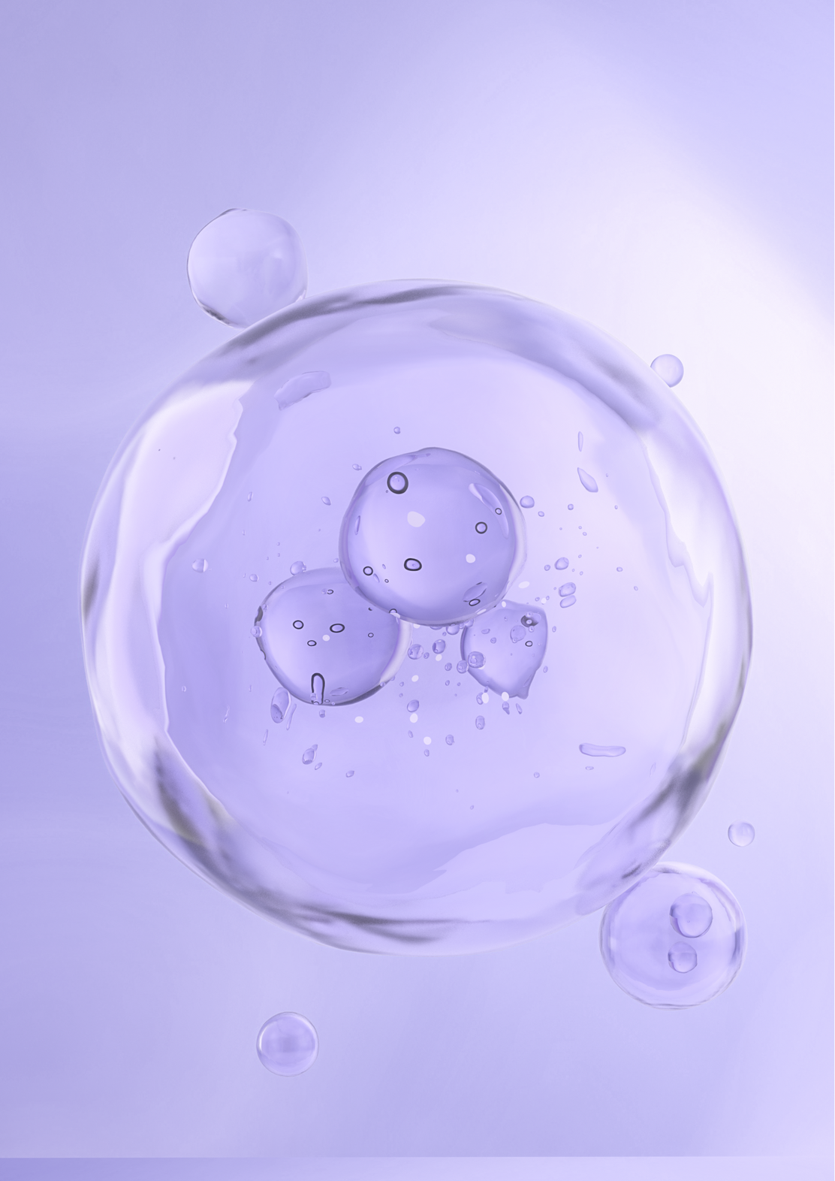
Data Collection
QM40 Molecular Dataset (Kaggle)
Contains ~163,000 neutral molecules from the ZINC database (C, N, O, S, F, Cl)
Provides quantum mechanical data: geometries, energies, Mulliken charges, vibrational properties
Suitable for training and evaluating ML models on structure–property relationships
Manageable size compared to larger QM datasets
Why QM40?
Initial plan: OMAT24 dataset → too computationally intensive
QM40 = efficient alternative for experimentation
Covers diverse molecular properties without overwhelming resources

Slide 7
Appendix
References
AI Tools Assistance
Gilmer et al. (2017) – Neural Message Passing for Quantum Chemistry
Veličković et al. (2018) – Graph Attention Networks
Krenn et al. (2020) – SELFIES robust molecular representations
Jin et al. (2018) – Junction Tree VAE for molecular graph generation
Shi et al. (2020) – GraphAF autoregressive flow models
ChatGPT (GPT-5) – Assisted in drafting diagrams, flowcharts, code explanations, and slide content.
Gemini – assistance in code and debugging

Slide 8

THANK YOU

